Slide 1
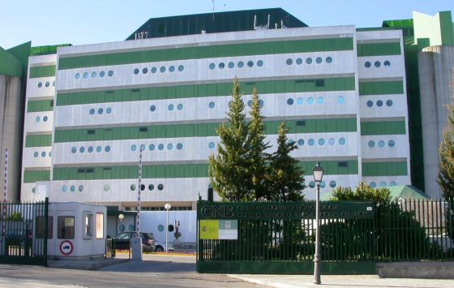


Escuela Politecnica Superior
Instruct Image Processing Center, CNB-CSIC
Roberto Marabini Ruiz

Slide 2

Scipionbox: A framework towards Integration and Reproducibility in 3D Electron Microscopy
Escuela Politecnica Superior
Instruct Image Processing Center, CNB-CSIC
Roberto Marabini Ruiz
Notes:
2
Hello, I am Roberto Marabini
2

Slide 3
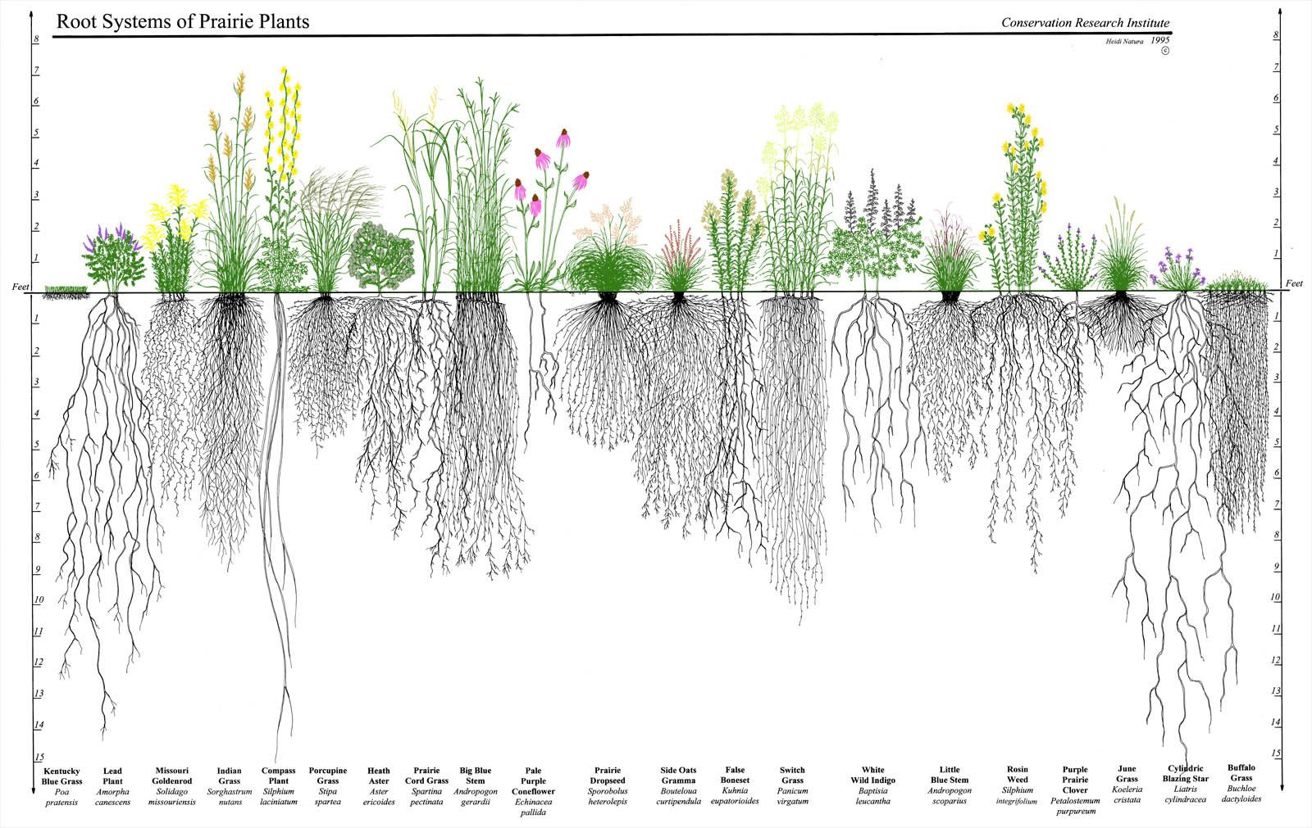

What People See
What Happens Underneath

Slide 4
Goal
Notes:
Present what we do:
4

Slide 5
Goal
Detect problems at early stages
Provide a first evaluation of the data quality
Save computing time
Notes:
Present what we do:
5

Slide 6

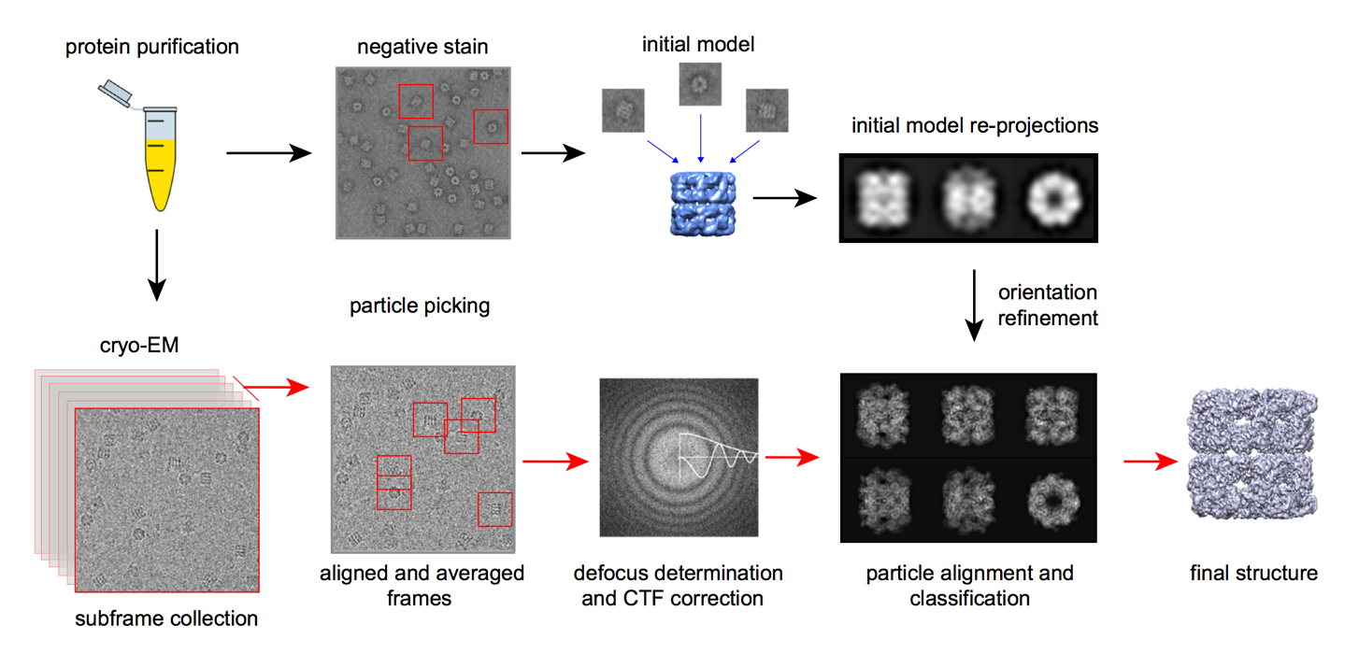
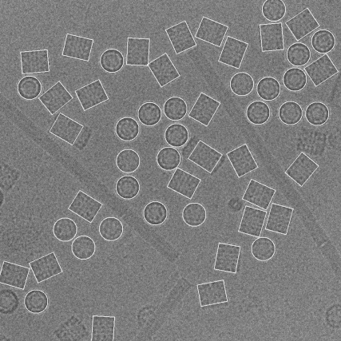
movie collection
particle picking
Notes:
http://www.creative-biostructure.com/em-platform_66.htm

Slide 7
SetUp
At
CNB
Notes:
Present what we do
Focusing on
Overview
And I would like to present you the work we develope at the I2PC in the area of image processing.
Let me show in a single slide the kind of work we do and then I will focus on workflows and data management
7

Slide 8
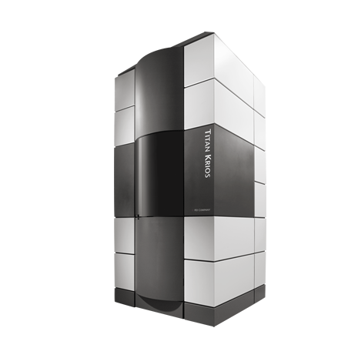




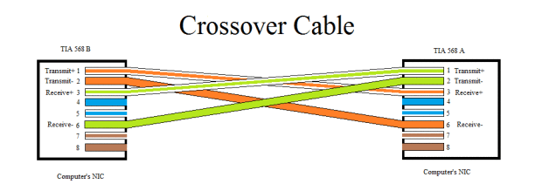



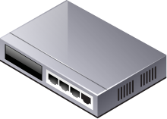


Control Mic.
Local Storage
1 Gbit/sec
USB-3
Firewall
1 Gbit/sec
Microscope
BBCP
LAN Storage
WAN Storage
/ processing
Cloud Processing
Notes:
bbcp does not encrypt the data stream

Slide 9
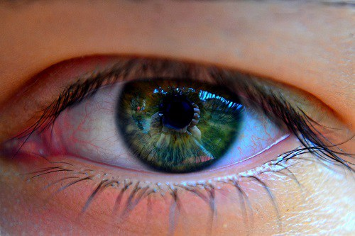
User Point of View
Notes:
Present what we do
Focusing on
Overview
And I would like to present you the work we develope at the I2PC in the area of image processing.
Let me show in a single slide the kind of work we do and then I will focus on workflows and data management
9

Slide 10
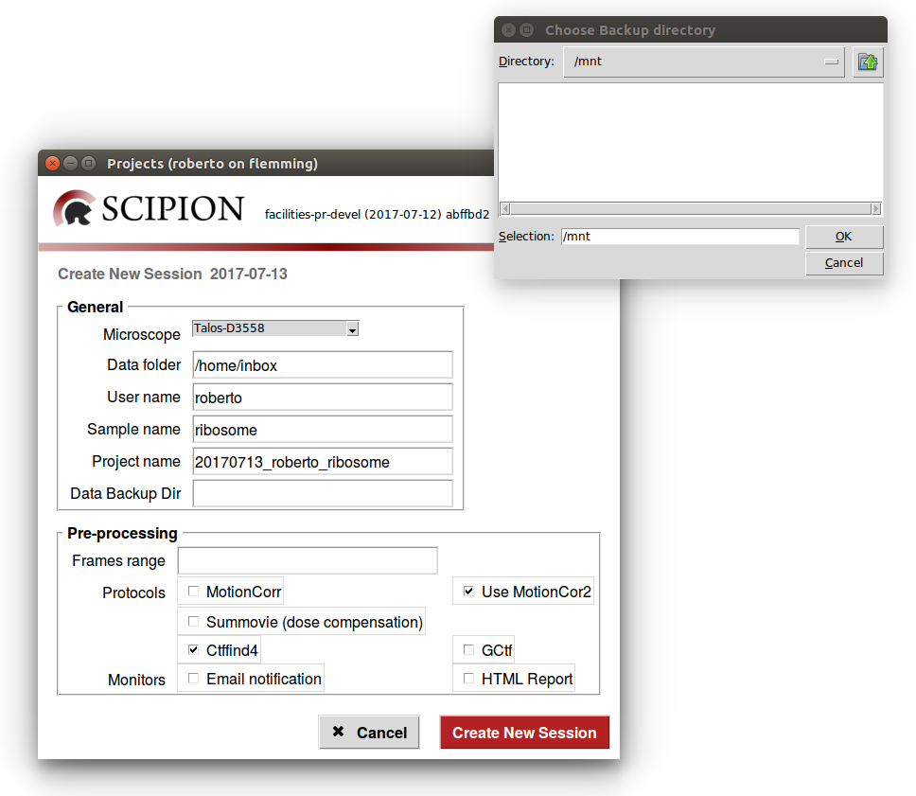
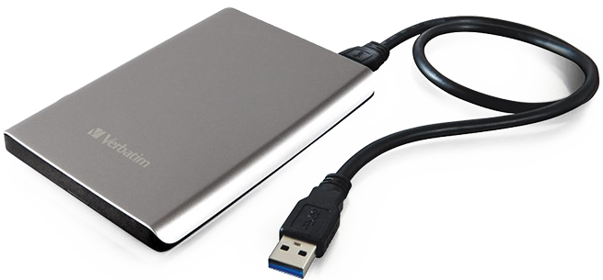

Launch
roberto@clar.cnb.csic.es:

Slide 11
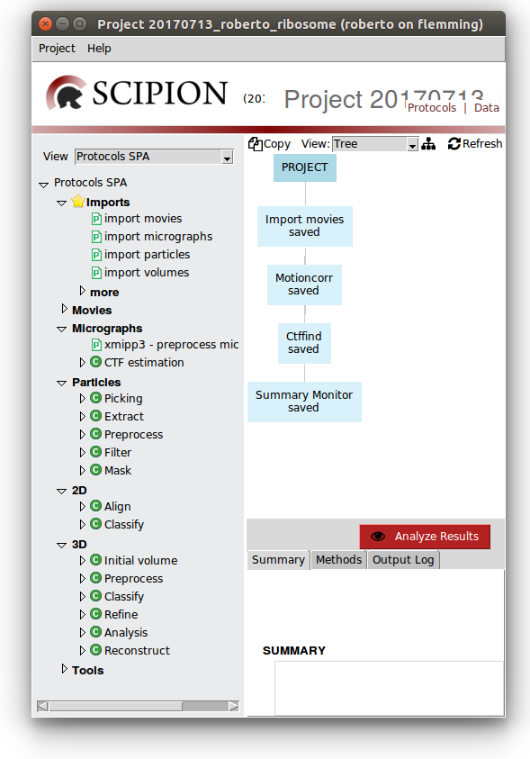
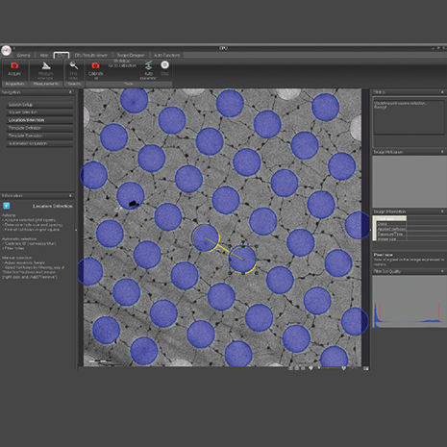
20170713_roberto_ribosome ├── GRID_01 │ ├── ATLAS │ └── DATA
| … ├── GRID_12 │ ├── ATLAS │ └── DATA └── ScipionUserData └── projects └── 20170713_roberto_ribosome
Notes:
Como se asigna EPU to directorio

Slide 12
Reliable
Simultaneous users (move data out while taken Image)
Alerts – reporting
Considered as a side service [not part of the microscope fee]

Slide 13
Testing
Notes:
A new release implies
13

Slide 14
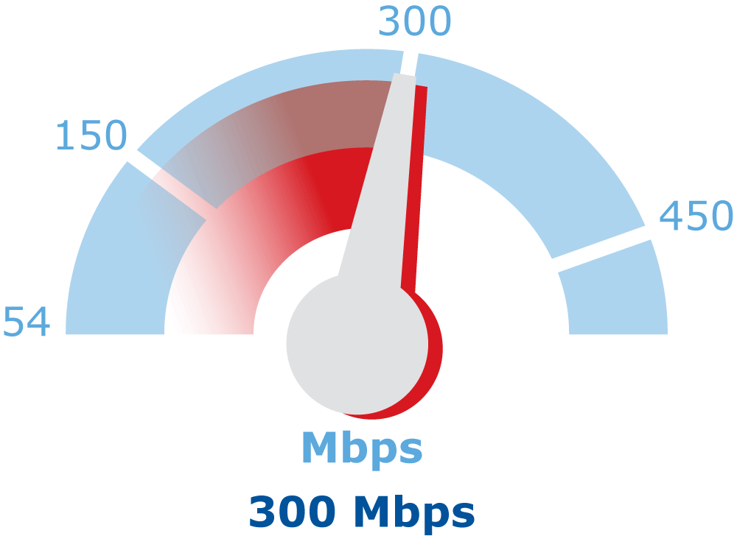

Slide 15
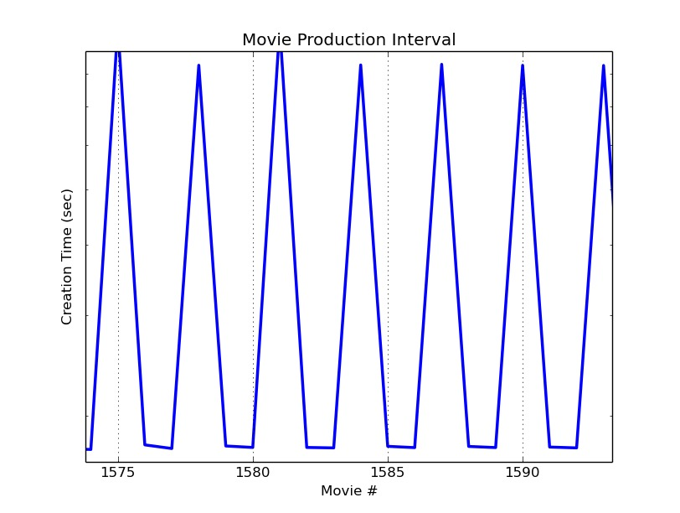
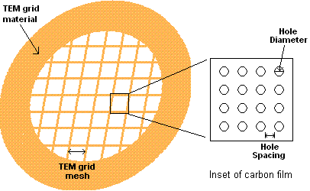
Frames per movie | 18
Number Movies | 6321
Total Acquisition time | 4 days (7 hours preparation)
Time per Movie | 55 sec
Time per Movie (mode) | ~17 sec
Dose per frame | 1.68 e/A
Total Dose | 29 e/A
Voltage | 200 Volt
Dose Filter=0 | 24 e/A
Movie Size | 623 MB

Slide 16

Notes:
People see this
What really happend

Slide 17
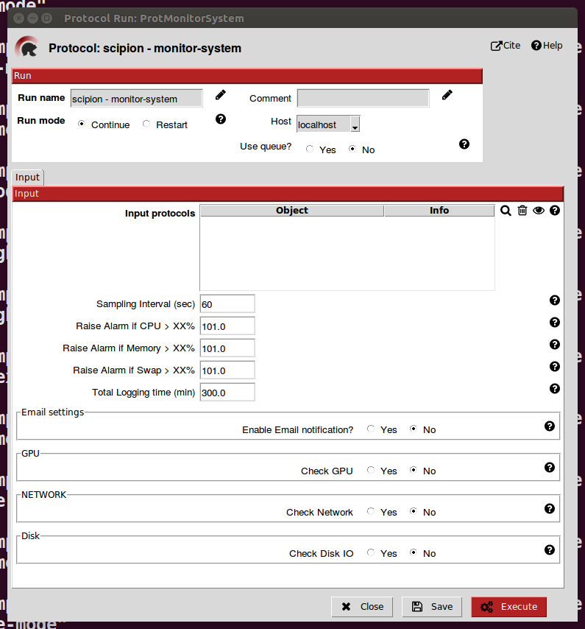
Notes:
Data optained using monitor

Slide 18
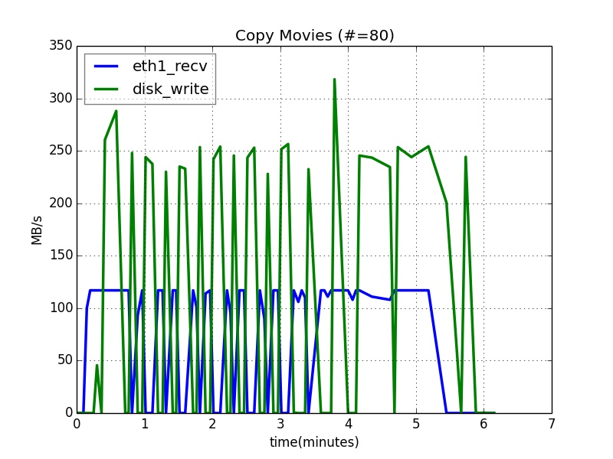




8.25 sec, movie
Notes:
How much time is spent moving a movie to scipion box?
80 images, no periodicity
80 -> movies (cp_movie.bat) -> 8.25 sec, movie
19 -> 623K
32->1.049K
Comentar 17 es el target

Slide 19
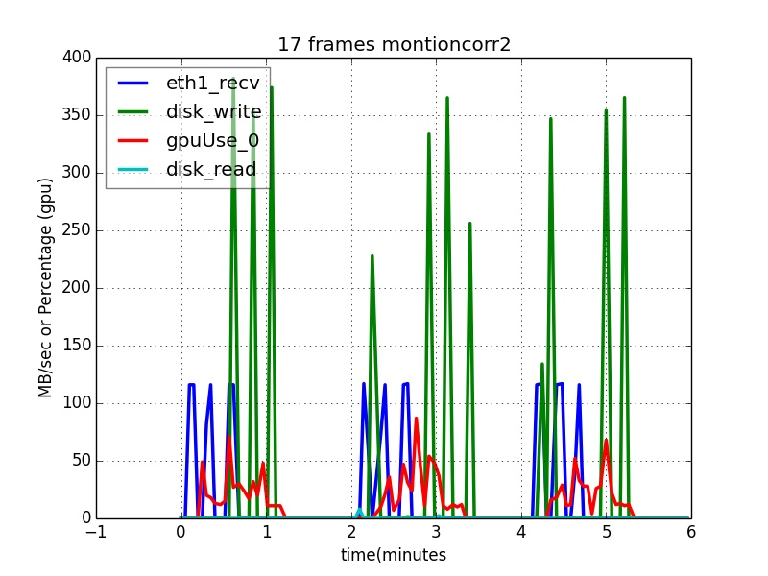
Notes:
Recv by eth1
Delayed write but in cycle
NO READ (buffer) – do not delay if you want to use buffer
GPU activity//half cycle so OK but see next overhead --< better results 2 threads
Generate each 17 seg and then wait 60 sec each 3 run motion coor -nothing -add backup -add network
Explicar wen detalle sistema de buffer

Slide 20
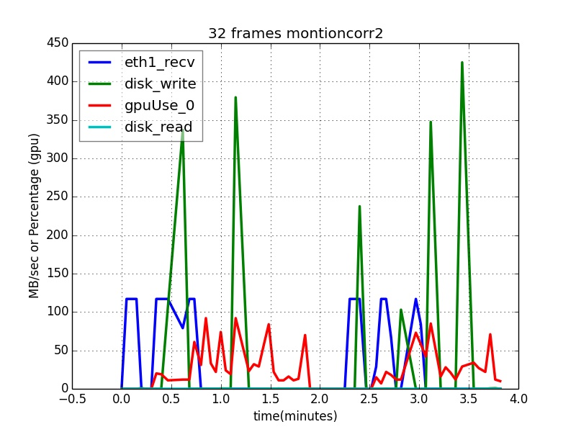
Notes:
With 32 (titan) no much difference in adquisitiont time but here is not much free GPU. Two GPUs is a must

Slide 21
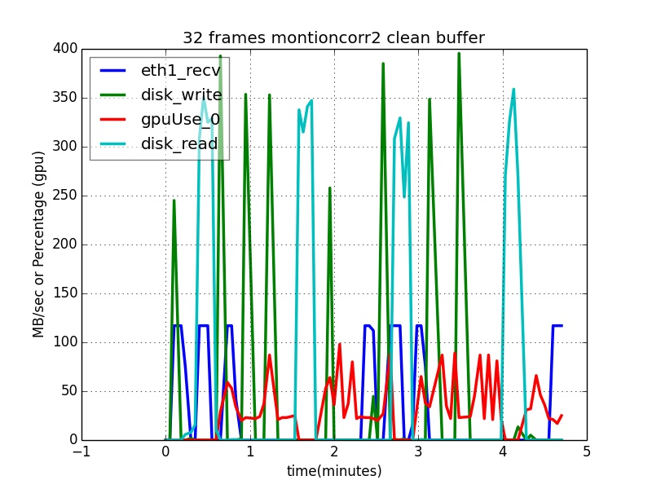
Motioncorr2 50 -> 1.10 min.
Notes:
Now we have read and the pace is equal.
Por que se puede llegar a esta situacion

Slide 22
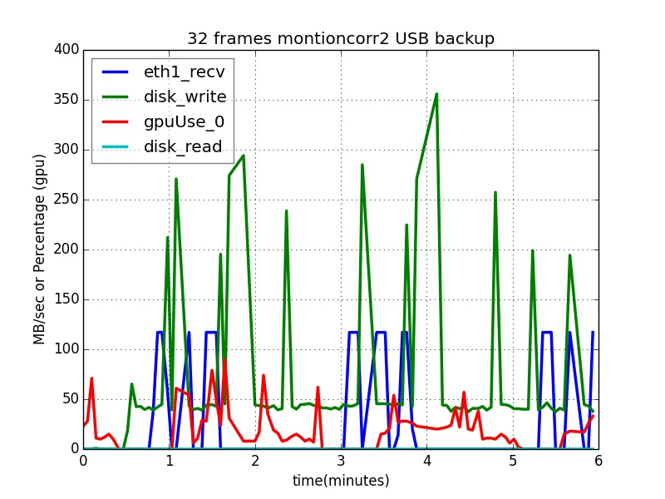
Notes:
Read is bad so what about local backup, with and without reading

Slide 23
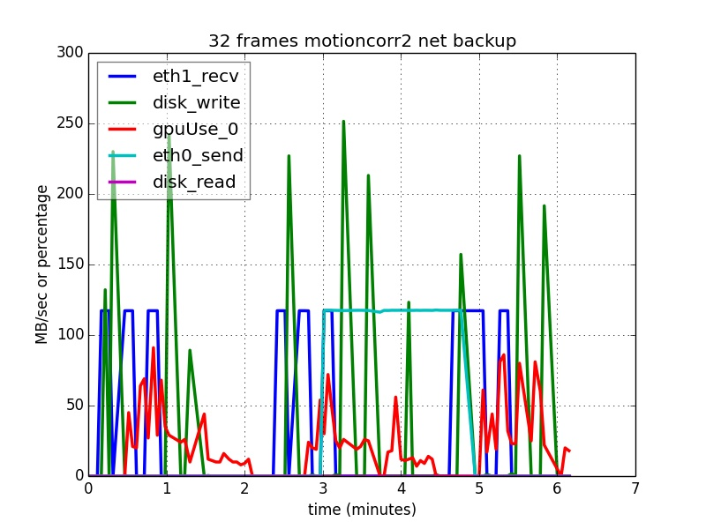
Notes:
Lan backup
Show disk read –write lan1 lan2
Consistencia de colores

Slide 24
Notes:
Lan backup
Show disk read –write lan1 lan2
As before but clean buffer

Slide 25
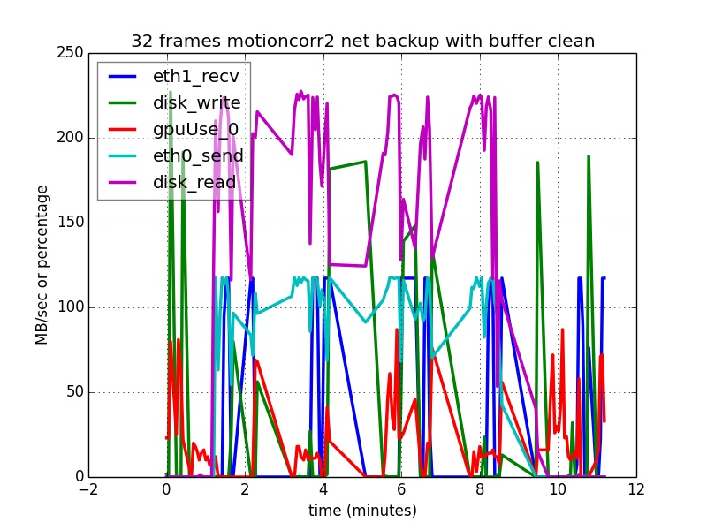
Notes:
Lan Backup plus net backup (Two user working at the same time)
The system still keeps up

Slide 26
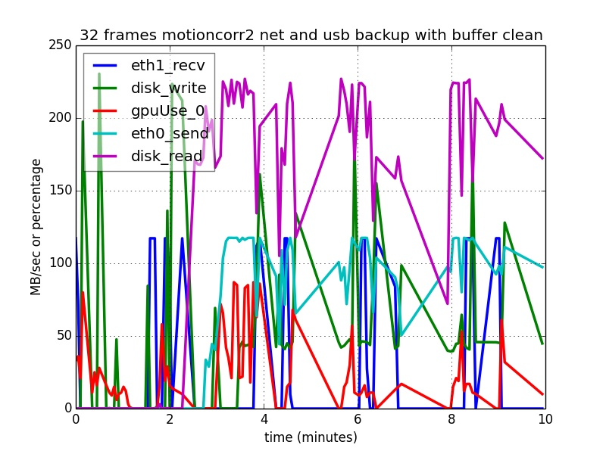
Notes:
Net and usb backup plus buffer clean
Still scipionbox can handle the task

Slide 27
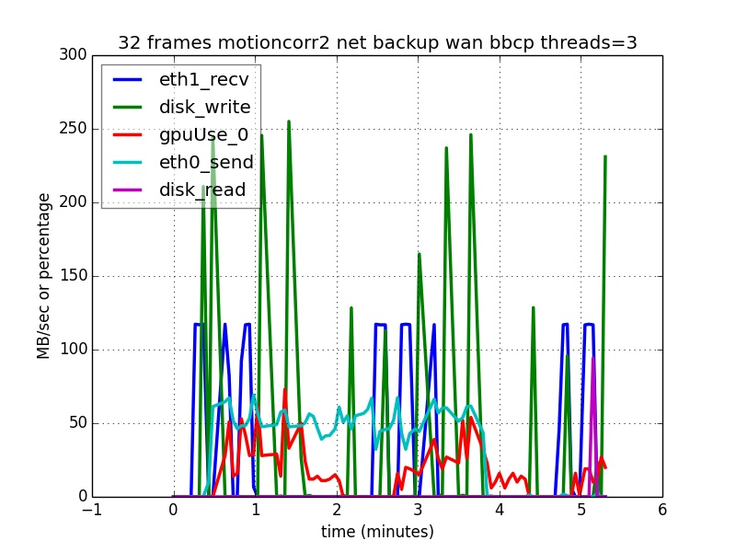
Notes:
Wan backup bbcp with 3 thredas
Port 5031 is needed alternatively 80 but you need to be root

Slide 28
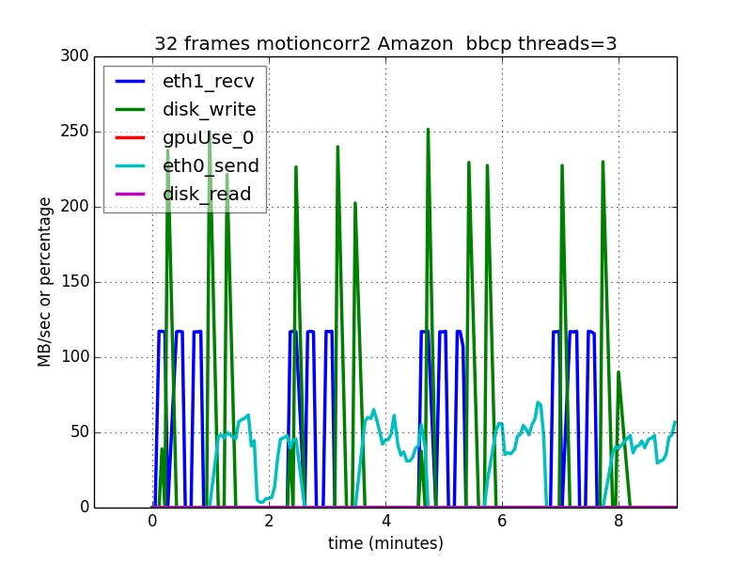
Notes:
amazon

Slide 29
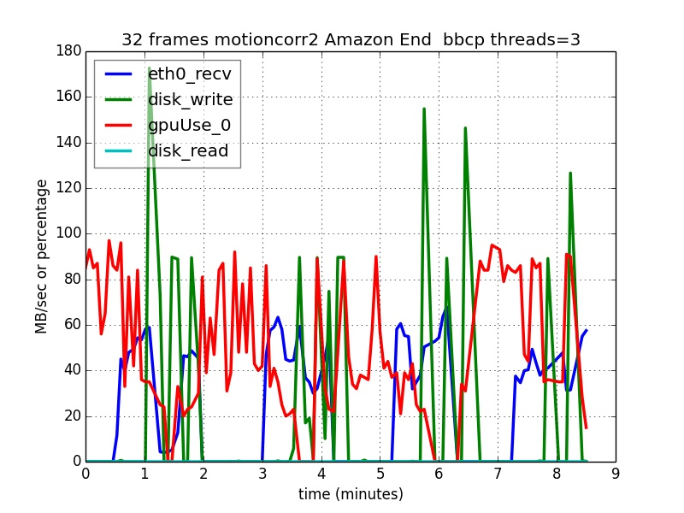
Notes:
Emails, sms, web server

Slide 30
Notes:
Present scipion script
-- report
-- email and warning
-- backup
--
Conclusion

Slide 31
Notes:
TODO: rcontinuar, importar -> importar movies dos veces, motioncor
-> Execute all
-> parada NN hours no suficientes posiciones continue

